Slide 1
Solution to Tutorial 7, Question 2
2. A 415 V, 50 Hz, three-phase distribution system supplies a 20 kVA, three-phase induction motor load at a power factor of 0.8 lagging, and a star-connected set of impedances, each having a resistance of 10 Ω in series with an inductive reactance of 8 Ω. Calculate the phase capacitance of delta-connected capacitors required to improve the overall power factor to 0.95 lagging.
Ans: 72.1 μF

Slide 2
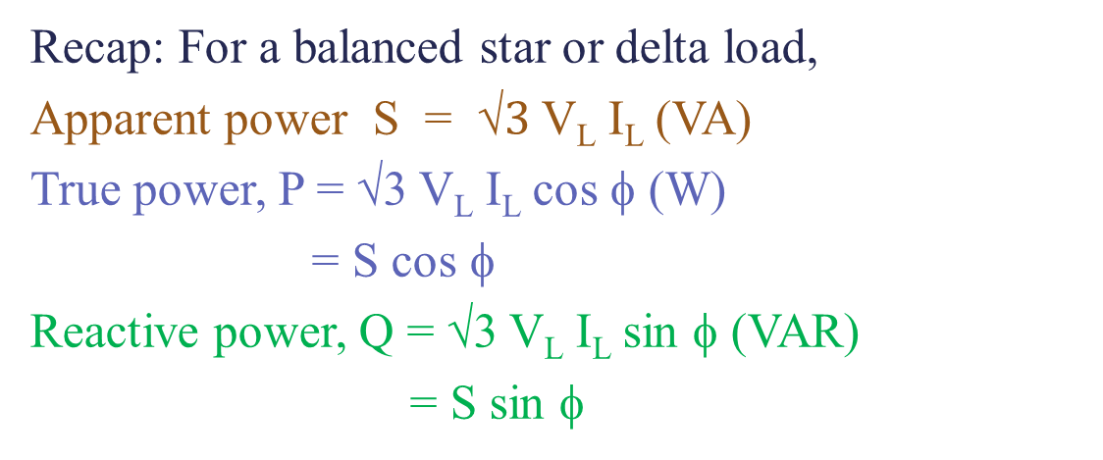
Solution to Tutorial 7, Question 2
Solution:Given V_{L} = 415 V, f =50 Hz,
Load1: Induction Motor, S_{IM}=20 kVA,cos Φ_{ΙΜ} = 0.8 lag
Load2: Z_{Y} = (10+j8) Ω
Δ-Capacitor Bank added- new pf = cos Φ₂ = 0.95 lag
Recap: For a balanced star or delta load,
Apparent power S = √$3$ V_{L} I_{L} (VA)
True power, P = √3 V_{L} I_{L} cos φ (W)
= S cos φ
Reactive power, Q = √3 V_{L} I_{L} sin φ (VAR)
= S sin φ

Slide 3
Load 1 – Induction Motor
Solution:
Load 1: Induction Motor
S_{IM}
Q_{IM}
P_{IM}
lagging power factor

Slide 4
Load 2- Star-connected impedances
Solution:
Load2: Z_{Y} = (10+j8) Ω
Q_{Y}
P_{Y}
lagging power factor

Slide 5
Power Triangles of Combined Loads
Load 1 – Induction motor
Load 2 – Star-connected load
S_{IM}
Q_{Y}
Q_{IM}
P_{Y}
P_{IM}
lagging power factor
lagging power factor

Slide 6
Power Triangle of Combined Loads
Q₁
P₁

Slide 7
Power Triangle of Capacitor Bank
Introduce delta-connected capacitors for correction
To improve to 0.95 lagging
S_{C} = Q_{C}
Capacitor Bank Power Triangle
Q₁=20.4 kVAR
P₁=26.5 kW
Combined loads Power Triangle

Slide 8
Power Triangle of after Correction
After Power Factor Correction
New power factor = cos φ₂ lagging
S_{C} = Q_{C}
Q₁ = 20.4 kVAR
Q_{T} = Q₁ - Q_{C}
φ₂
P₁= 26.5 kW
= P_{T}

Slide 9

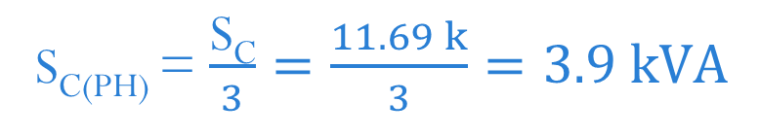
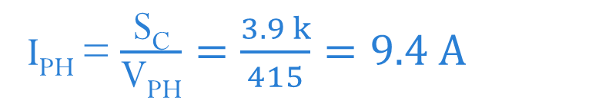
Value of the Phase Capacitor
From rating of capacitor bank, Q_{C} = S_{C}
S_{C(PH)} = $\frac{\text{S}\text{C}}{3}=\frac{11.69 k}{3}=3.9 kVA$
$$\text{=}\text{V}\text{PH} \text{I}\text{PH}$$
Capacitor bank connected in delta
Phase voltage of capacitor bank = line voltage = 415 V
I_{PH} = $\frac{\text{S}\text{C}}{\text{V}\text{PH}}=\frac{3.9 k}{415}=9.4 A$

